Slide 1
AUTO INSURANCE FRAUD DETECTION
Harika Tumula – 700741664
Ravali Bhoothpuram - 700742316

Slide 2
Roles
We have established this method through zoom calls, screen sharing was conducted among the developer navigator pairs. The developer will share the screen while the navigator views it and gives suggestions or feedback, and the developer instantly applies the ideas that are shared by the navigator in code to improvise. Other than this pair programming we also followed the scrum method. We have assigned tasks and shared work equally.
We have conducted meetings every week to exchange the status update and assign new tasks for the following week. This approach helped us in finishing our work and meet the deadlines assigned. The evidence is attached in an agile user stories document and submitted along with this report. All five in the team have worked and shared work equally which led us to successfully build a classification model and finish this project.

Slide 3
Responsilities
Our approach includes comparison of various supervised machine learning models to check which algorithm performs efficiently in categorizing fraud insurance claims.
To achieve this data is first evaluated for biasing issues before model creation because most fraud detection datasets are imbalanced, and this biasing is addressed using SMOTE (Synthetic Minority Over Sampling Technique). Using the python module scikit learn, this balanced dataset is then utilized to train several machine learning algorithms and various metrics like accuracy, F1-score are calculated.
Further to improve accuracy, hyper tuning of parameters using random grid search is done to check for optimal parameters. The metrics of multiple models are compared using this parameter, and the model with overall better performance is stored in a pickle file.

Slide 4
Motivation
Keeping in mind giving something useful to society, we have tried to implement a system using machine learning that helps to detect automobile insurance frauds. As per the insurance information institute, it is shown that only 3% of the fraud vehicle insurance cases have been detected and it would be a huge improvement for the auto insurance company. Hence, our system can benefit both the users to claim auto insurance and the car insurance companies to avoid payments to fraud cases to save money and time.

Slide 5
Objectives
⦁ The dataset generated from the Kaggle is preprocessed and transformed data is accessible to the public where they can easily download and apply models to detect insurance frauds.
⦁ We are applying four different machine learning models to find the most accurate model to detect the insurance claims.
⦁ In future companies can use directly use this model and detect frauds.

Slide 6
Related work
The purpose of our project is to help insurance companies to detect fraud insurance claims to avoid unethical and unnecessary payments to the false claims.
In order to achieve this goal, we need to build machine learning models to have the ability to determine whether it is a false claim or not based on the input insurance claim data.
Hence, we need data about each claim in terms of information about the insurance claimer like income, age, education and claim history, as well as information about the car like car type, car usage purpose and car age. During our literature survey, we found this dataset from Kaggle including information of details about each claim.

Slide 7
Related work
In order to get our data ready for further analysis and model building, we first check for missing values. The result shows only one column has all null value, and we drop that column since it is meaningless for our project. Also, we check box plot for each feature for outlier value and we find outliers exist in feature ‘umbrella limit’ which is handled later in the data transformation section. As for duplication, there are no duplicate data entries in our dataset.
To ensure random sampling of data selection each time, we use train test split function to select training and testing data with random state equals 20.
During the exploration of our dataset, we also found several columns have too many unique values and it is not helpful for us to build a generalized model, so we decide to drop column ‘incident location’, ‘policy bind date’, ‘insured zip’, ‘incident date’, ‘authorities contacted’, ‘auto make’, ‘auto model’ to perform feature reduction.
Last, we transform non-numerical data to numerical data by encoding so all data fields are in numerical type in order to visualize and build machine learning models.

Slide 8
Related work
To get a better understanding of the dataset, we use the ‘describe’ method to get a statistical report. For numerical data types, we find the mean, std, min and max value. For object data types, we find the unique value count and top value frequency. We also visualize the distribution of the target variable, and we know we have an imbalanced target variable. There are only 25% fraud claims with remaining 75% claims being honest claims. We handle imbalanced data later. We use count plot to visualize discrete variables.
To gain a deeper understanding of relations of each parameter with fraud claims, we conduct more visualizations. From the graphs, we can conclude there is no clear correlation between ‘month as customer’ and fraud claim amount. And for a claim amount around 60000, it is more likely to have fraud claims due to the impressive money gain. While for claim amounts below 20000, it is less likely to have fraud claims due to the limited money gain and claimants would think not worth forgery.

Slide 9
Problem Statement
To accurately forecast fraud insurance claims, which is a classification problem using the labeled data, we used supervised learning algorithms to see which one best suit for detecting automobile insurance fraud and assisting organizers in reducing losses.

Slide 10
Proposed Solution
We tried five different machine learning models to detect the best accurate model for our project. First, we compared all the models without applying any tuning, the accuracy score of all the models obtained was mostly high which indicates low bias. However, we cannot simply rely on accuracy as our dataset was biased which was also evidence from specificity and Cohen Kappa score of models. So, the main step here was to remove dataset bias by using some oversampling technique, hence we used SMOTE which is an oversampling technique in which samples for the minority class are formed from existing samples using KNN, typically with K=5.
After SMOTE dataset was balanced having equal number of both the classes, using this dataset we ran all the model again and compared various metrics, this time accuracy was increased as compared to first case , Also we can see improvement in Cohen Kappa which tells that accuracy is not by chance, but it is actual accuracy of your model. Then we also concentrated on F1 score of models and precision score as our main aim was to detect fraud cases and precision is one metric which tells us how many fraud cases were correctly detected. In this comparison we finally chose SVM, Random Forest and XGboost as all of them were performing better. Lastly, we compared models and checked for Cohen Kappa, F1 score and precision recall curve to select the best model in detecting fraud cases.

Slide 11
In the next step we first we compared all the models without any treatment then to select the most accurate model, we have calculated performance metrics for each model and compared the metrics among them then came up with the final model with high performance. Initially we applied all the models without any tuning in the dataset, the dataset was imbalanced, and we observed the specificity is very low. Also, precision and recall curve for minority class is less. Cohen kappa score for imbalanced data is below 50%. So, used synthetic minority over sampling technique (SMOTE) to handle the imbalanced dataset. Using the standard scaler method scaled down all the input values. Then after applying SMOTE again applied all five machine learning models then Cohen kappa score has been increased. We have dropped some features like C39 which has a greater number of null values and is not useful for analysis.
After SMOTE we have done hyper tuning and applied it to all models. So, performance metrics for all five models without sampling, with SMOTE and with hyper tuning has been done and noted. Considering all these scenarios one best high-performance model will be chosen for detecting insurance frauds.

Slide 12
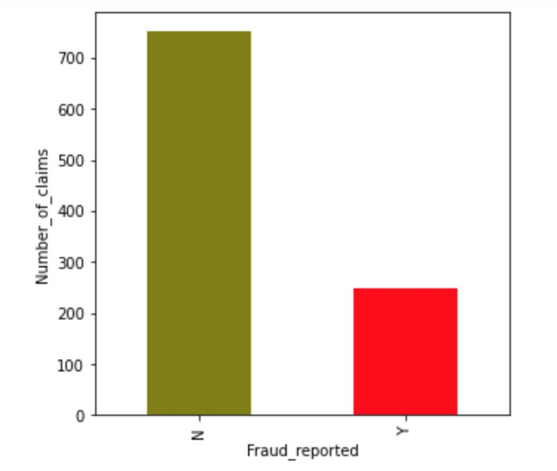
ax = pd.value_counts(df['fraud_reported']).plot.bar(color=['olive', 'red'], figsize=(5,5)) ax.set_xlabel('Fraud_reported') ax.set_ylabel('Number_of_claims') plt.show()
Figure 4. Number of claims vs Fraud Reported

Slide 13
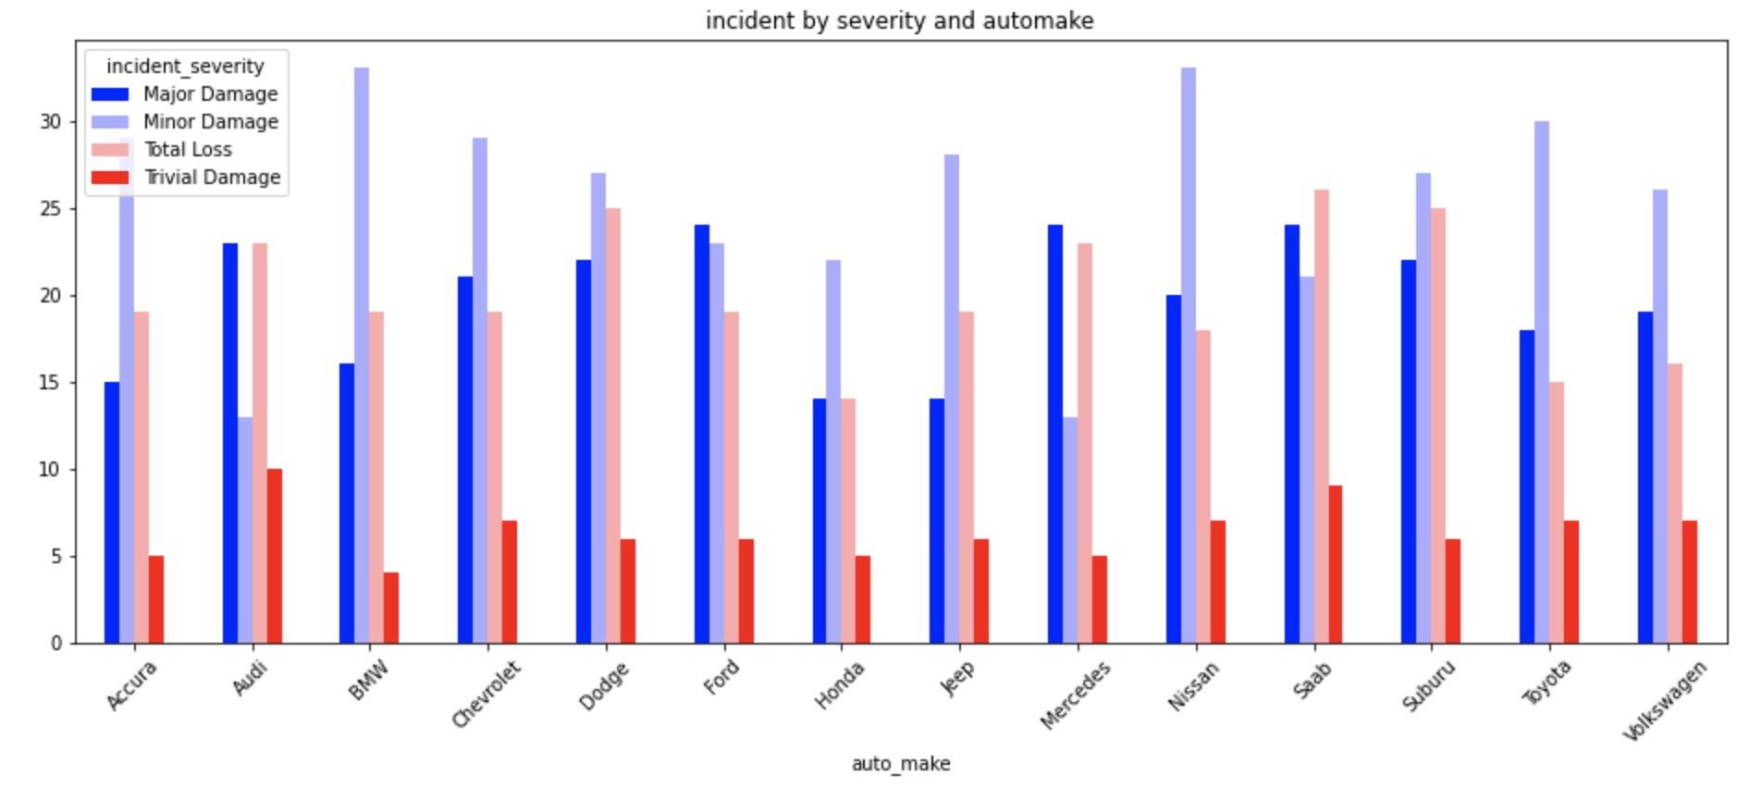
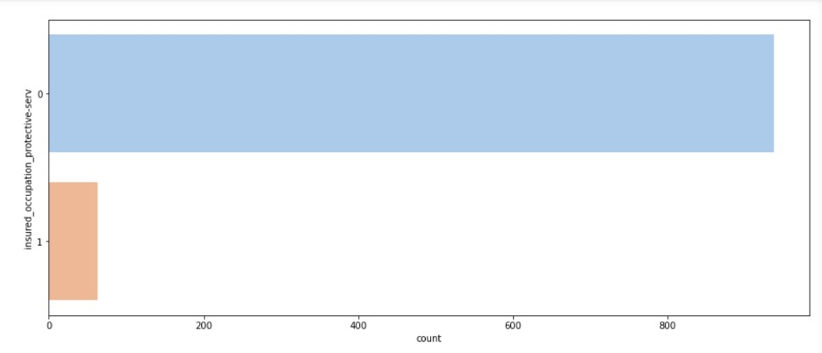
Figure 5. Incident Severity vs Auto Made
Figure 6. Insurance Occupation vs Fraud Count

Slide 14
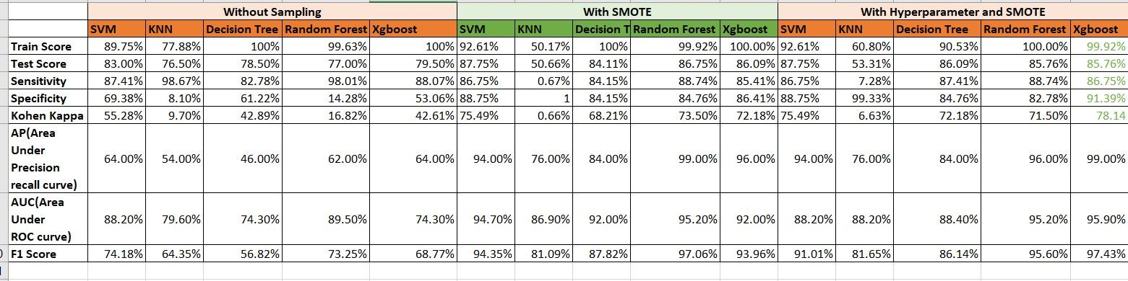
Below table summarizes the metrics of all models developed in this project:
Figure 14. Metrics of All Models

Slide 15
